Slide 1
While you wait
https://cs110.students.cs.ubc.cs/lectures/110-intro.pdf <<< Slides!
https://cs110.students.cs.ubc.ca/admin/links.html
Follow Setup link
skip to installing DrRacket
but stop when you get to “setup test file”
that will let you type at DrRacket for class
go back after class and do skipped setup page steps IN ORDER
Or, do all this after class and just use pen and paper during class!

Slide 2



CPSC 110
Systematic Program Design
Who, Why, What and How
Start working on the first module
Don’t worry – this is not a powerpoint course
Powerpoint?
Ugh!
Notes:
switch back and forth between first two slides before class

Slide 3
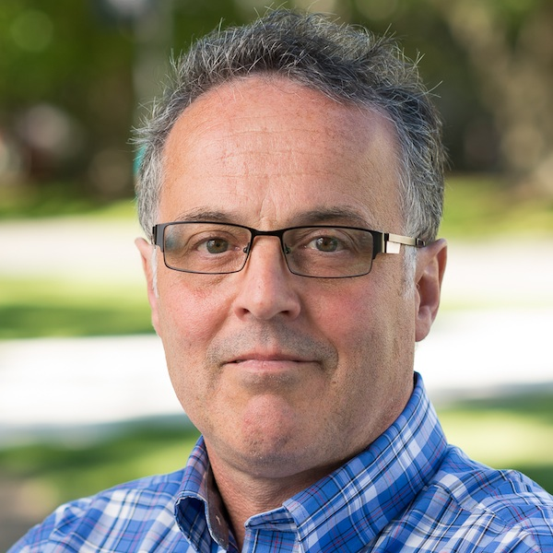
Who?
Gregor Kiczales (he/him/his) Professor of Computer Science Fellow, Association of Computing Machinery
Research in programming languages and program design Common Lisp Object System (CLOS) Portable CommonLoops (PCL) Metaobject Protocols (MOPs) Art of the Metaobject Protocol Aspect-Oriented Programming (AOP) AspectJ EdX Systematic Program Design (aka How to Code) courses

Slide 4
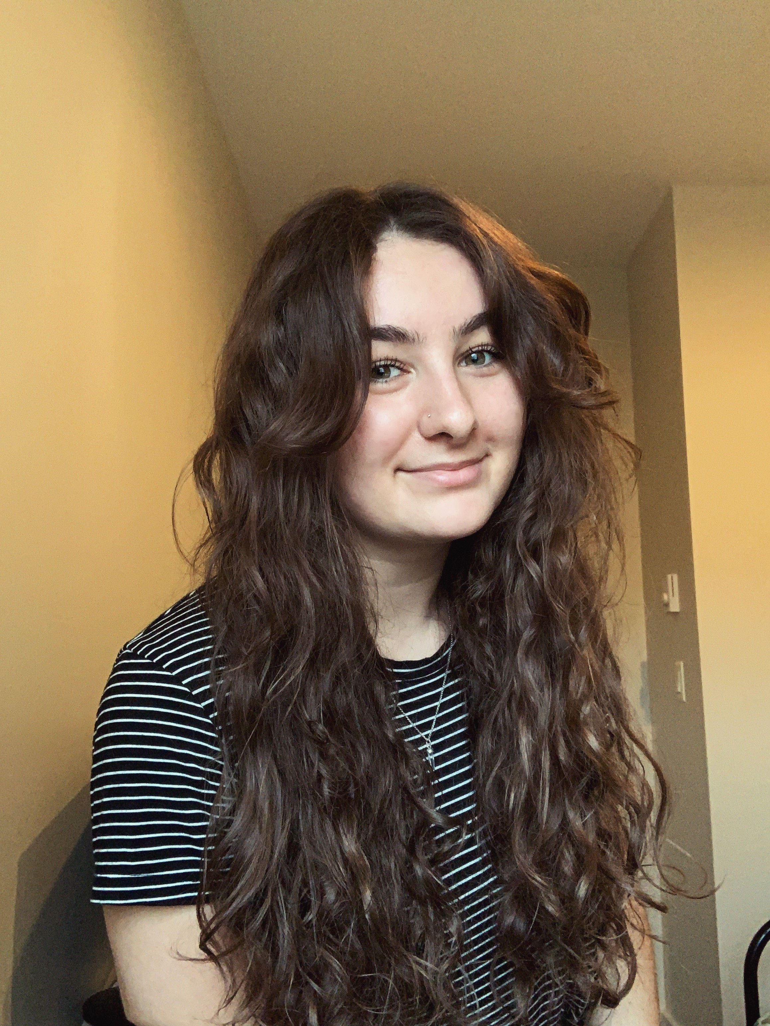
Who?
Emily Fuchs Course Coordinator
cpsc110-admin@cs.ubc.ca <<< administrative question go here Technical questions go to Piazza only sensitive personal issues go to instructor email
+ 50 TAs who work on labs, office hours, Piazza, and grading

Slide 5
Who? (you)
By year:
1st 58%
2nd 22%
3rd 14%
4th 3%
No programming experience required!
people with programming experience usually catch up to people with no programming experience in 3-4 weeks
By program
BSC 55%
BA 29%
BCOM 6%
I don’t - I’m ahead of you!
I know how to program

Slide 6
What?
Margaret Hamilton accepting US Presidential Medal of Freedom
Apollo moon mission software development lead
“How can I be sure the software will work so that people don’t die?”
Foundations of software engineering
more than just programming

Slide 7
Key ideas (1/5)
quickly today
but you will hear these throughout the course
Code that works properly is not nearly good enough
Need to be able to explain how you developed it
Need to be able to explain why you are confident it works properly
Need to be able to reliably produce similar programs
Software development is a team activity
How we work determines what we produce
Representing information as data
Programs have structure

Slide 8
Key ideas (2/5)
Code that works properly is not nearly good enough
Software development is a team activity
useful programs always have to be modified by other programmers later
being kind to other developers is essential to success
applies to the code we produce, the questions we ask, the answers we give
How we work determines what we produce
Representing information as data
Programs have structure
kindness starts on Piazza!

Slide 9
Key ideas (3/5)
Code that works properly is not nearly good enough
Software development is a team activity
How we work determines what we produce
we can’t rely on jolts of brilliance
ACM Code of Ethics 2.1 Strive to achieve high quality in both the processes and products of professional work.
Representing information as data
Programs have structure

Slide 10
Key ideas (4/5)
Code that works properly is not nearly good enough
Software development is a team activity
How we work determines what we produce
Representing information as data
information is out there in the world
programs operate on data inside the computer that represents that information
Programs have structure

Slide 11
Key ideas (5/5)
Code that works properly is not nearly good enough
Software development is a team activity
How we work determines what we produce
Representing information as data
Programs have structure
of different kinds
local and crosscutting
being able to design in terms of that structure is powerful

Slide 12
Systematic Program Design (SPD)
Working systematically can reliably produce well written, consistent, and well tested programs.
Based on research and practice in programming languages and software engineering.
Provides a foundation for professional software development
Also relevant if you are NOT intending to be a software developer
helpful for programs of all sizes, including 2 page quick programs
underlying ideas help with all kinds of problem solving and design

Slide 13
What about ChatGPT (generative AI)?
What happens if you copy code from ChatGPT?
Can you:
explain how you developed it?
explain why you are confident it works properly?
reliably produce similar programs?
From someone who worked at Tesla: you would be fired
do you want (your) life critical code copied out of ChatGPT?
In 110 is as academic misconduct – aka cheating
We may offer a few optional evening lectures on using ChatGPT to increase confidence in code.

Slide 14
Basic course structure
First we use easy problems to learn SPD
then we use SPD to solve difficult problems
That cycle happens every lecture, every week, across the term
lecture starts w/ easy problem, then harder
module starts w/ easy problems, then harder
course starts w/ easy problems, then harder
a program to produce twice the given number (Tuesday)
a program to schedule 110 lab TAs (near end of the course)
The content and pace get more difficult as we go

Slide 16
Beginning Student Language (BSL)
Programs are written in different languages
There are 10s of thousands of languages; thousands in active use. Hundreds are popular.
No one language is the most useful, best etc.
BSL is the core of most other languages (lambda calculus)
allows us to focus on learning systematic program design
prepares you for learning other languages quickly
never say a university course taught a language
Puts all students on level playing field

Slide 17
Software Design is
Situated means we need to be able to use the right skill, in the right way, at the right time.
The situated selection and use of:
Design techniques
Science and engineering expertise
Tool skills
Team skills
Lecture and labs are based on situated learning. You work on solving a problem, we help you learn how to solve it.
Notes:
You will do better being bad at math than being bad at teamwork.

Slide 18
Learning by solving design problems
In lecture/lab/problem-sets/homework you will be working through program design problems
The real goal is NOT to simply handin a working solution to the problems.
It is to learn to solve the problem on your own.
If we help you too much, if you look at the solution too soon, if you get help from a friend, then you won’t learn how to solve them on your own.
It will be difficult, you will get stuck, your head will hurt – that’s called learning.
Watching your friend lift weights doesn’t make you stronger.

Slide 19
Course Components - Lecture
Before lecture you will work through videos and problems on edge.edx.org
10% of course grade is Zoom questions based on this material
Lecture will mix presentation of new material with you working on problems
“priming” enables situated learning of new topics
expect lecture to be difficult and tiring – experience doing real design
After lecture you will review material from lecture and work through additional videos and problems on edge.edx.org
🆕

Slide 20
Course Components – Lecture Starters
Working in DrRacket on in-class lecture problems
work during lecture
submit several times for each problem
you submit to autograder to get feedback
based on whether you are working systematically
can submit as often as you like (within reason)
this is formative assessment (lecture starter grades don’t count)
🆕

Slide 21
Course Components - Labs
Designing programs to solve more challenging problems
Lab number n covers lecture module n; so does problem set n
Answering design review questions from TAs
about your lab work
about the prior week’s problem set

Slide 22
Course Components - Problem Sets
Close out each module with a problem set that assesses your mastery of all the material to date
THE PROBLEM SETS PREPARE YOU FOR THE EXAMS
Collaboration policy is in the Syllabus READ IT! Cheating is stealing from other students and we won’t tolerate it.
Combined assessment:
automatic grading (autograder)
during lab a TA will ask you questions about how you designed the program

Slide 23
Course Components - Other
Office hours - instructor and TAs (See Piazza)
Midterms and final
assessment of your mastery of systematic program design
on campus
Unweighted average of all three exams must be >= 50% to pass the course (MT1-grade + MT2-grade + final-grade)/3 must be >= 50%
There is no textbook, everything you need is on edge.edx.org
https://cs110.students.cs.ubc.ca/admin/links.html

Slide 24
Grading Scheme
Item | % of total course grade
Problem Sets | 15%
Labs | 10%
Lecture questions (usually at start) | 10%
edX questions | 0% - These are a good for your learning though, so do not skip them!
Midterm 1 | 15%
Midterm 2 | 20%
Final | 25%
see https://cs110.students.cs.ubc.ca/admin/syllabus.html for critical additional points

Slide 25
110 vs. 103+107
110 is all of Systematic Program Design, in one term
best and fastest foundation for being a major or taking CPSC 210 (Software Engineering in Java).
103 is based on first 4-5 weeks of 110, working in Python
103 is a non-major course, less rigour, less depth
107 is the last 7 weeks of 110
intended for 103 students who decide they want to major in CS
in the teaching languages, using 110 edX modules.
107 students take the 110 final exam

Slide 26
What it takes to do well
Don’t need math, STEM, etc.
Must have:
attention to detail because a one character error can break a program
patience because it takes time to solve hard design problems
humility because simple looking problems can still be hard
Many of you have attention to detail, patience, humility
athletes, musicians, gamers, artists, …

Slide 27
Course Contract
Course staff will provide
state of the art content based on research and practice in programming and software engineering
delivered using state of the art pedagogy in active and online learning
supported by significant investment in materials and resources
50 person team, extensive office hours, rapid response to questions on Piazza
You will:
work hard (12+ hours/week outside of scheduled lab & lecture times) and stay up to date – not get behind by even a day
trust the design recipes to get you to a solution
follow course rules of decorum and academic honesty

Slide 28
After Class
https://cs110.students.cs.ubc.ca/admin/links.html
do Setup
read Syllabus
edX “after lecture 1”, and then “before lecture 2”

